Slide 1

Diabetes Prevalence In the United States
Maxwell Carduner
Kalaivani Chandramohan
William Chirciu
Ramkumar Perumal
Charles Saporito

Slide 2
Objective & Goal
30.3 million people had diabetes in the US according to a 2015 American Diabetes Association (ADA) study. This represents a national prevalence rate of 9.4%. Therefore, we have compiled county level prevalence rates with socio-economic and lifestyle indicators to see if they have a contributory effect to diabetes prevalence.

Slide 3
Data
Dependent variable: US diabetes prevalence % by county from CDC
Independent variables (all numeric)
Lifestyle indicators by county (source: CDC)
Obesity Prevalence %
Leisure Time Physical Inactivity Prevalence %
Socio-economic indicators by county
Unemployment rate
Household median income
Median age
% of adults with less than high school diploma
% of adults with a high school diploma only
% of adults completing some college or associate degree
% of adults with bachelor’s degree or higher
No transformations required

Slide 4
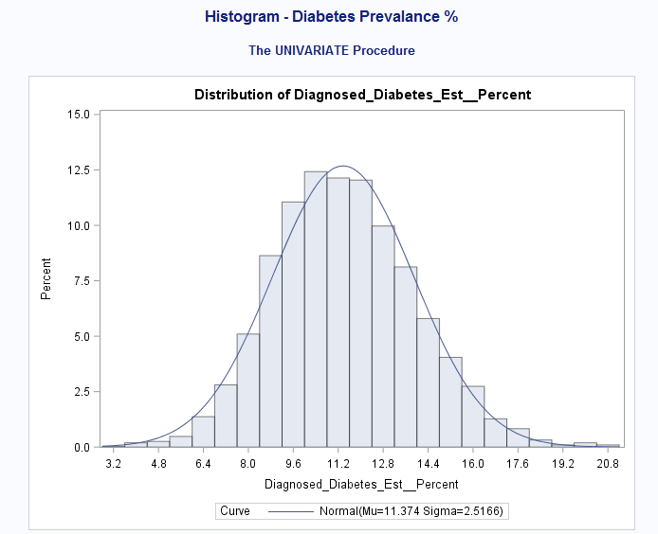
Distribution of Diabetes Prevalence % by County

Slide 5
High-Level Methodology (Max)
Checked for multi-collinearity of all variables with correlations and VIFs (none)
Created interaction terms:
Dropped insignificant interaction terms
Checked for multi-collinearity
Centered variables used in significant interaction terms
Ran linear model on variables after determining:
Normal distribution of dependent variable
Linear relationship between all independent variables and dependent variable
Model error terms are independent of each other, normally distributed and have constant variance
Outliers/Influential Points:
Less than 10 of 3000+ tuples were outliers and influential points, therefore left in model
Fit Final Model & Validate with Cross Validation

Slide 6
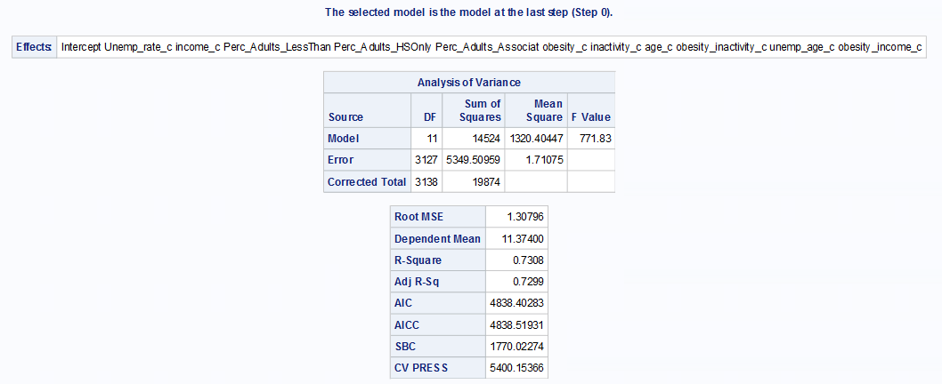
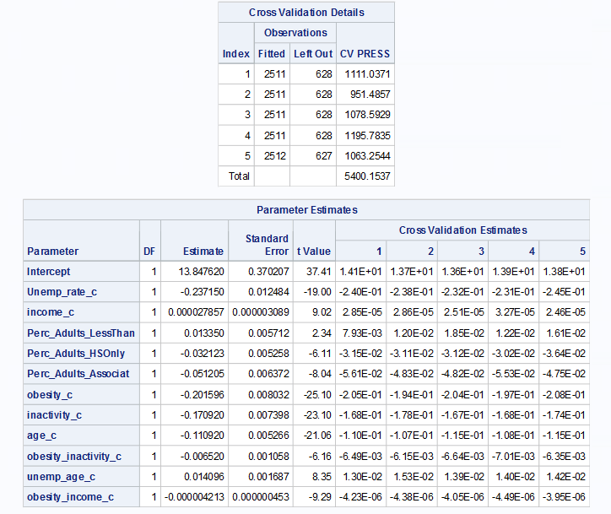
Max’s Final Model and Performance
All variables kept in model as significant with exception of % of adults with bachelor’s degree or higher which was deemed as a linear combination of other variables when fitting full model so it was thrown out.
F value at 771.83 and adjusted r squared at 72.99%
Interaction terms between obesity and inactivity, unemployment and age, and obesity and income were significant.

Slide 7
Differences in Methodology and Model Selection: Ramkumar Perumal

Slide 8
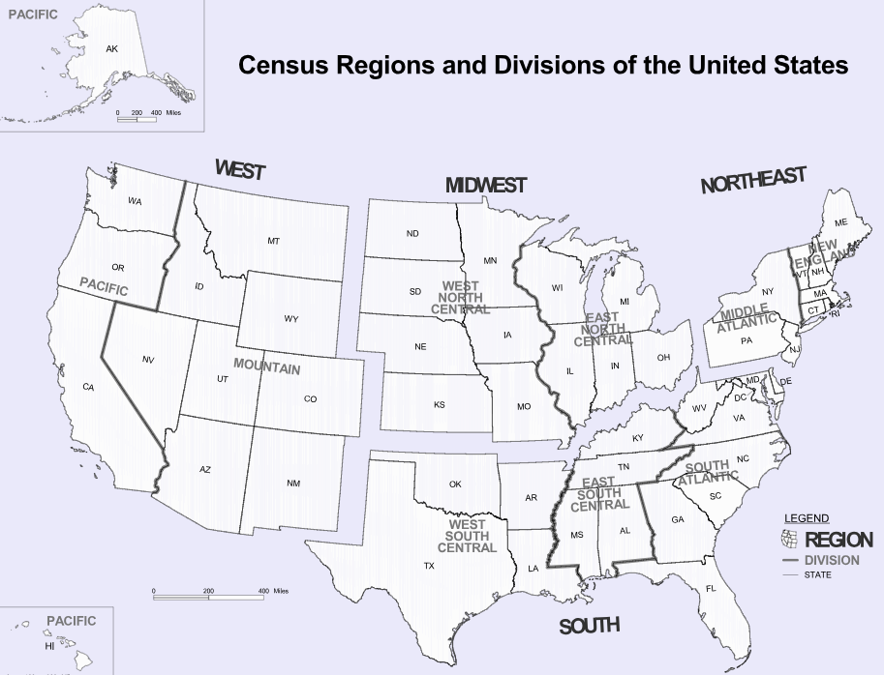

Data Processing
10 variables + Region
Diabetes Est. Percent (Diag_Pct) - Y variable
Unemployment Rate (Unemp_Rate)
Household Median Income (Income)
Percent of adults with less than a high school diploma (lt_HighSchool)
Percent of adults with a high school diploma only (only_HighSchool)
Percent of adults completing some college or associate's degree (Col_Degree)
Percent of adults with a bachelor's degree or higher (Bach_Degree)
Obesity Prev Percent (Obesity)
Leisure Time Physical Inactivity Prev Perc (Ph_Inactivity)
Median Age (Age)
Region
Notes:
There are 53 states, and I didn’t wanna miss a valuable predictor.

Slide 9
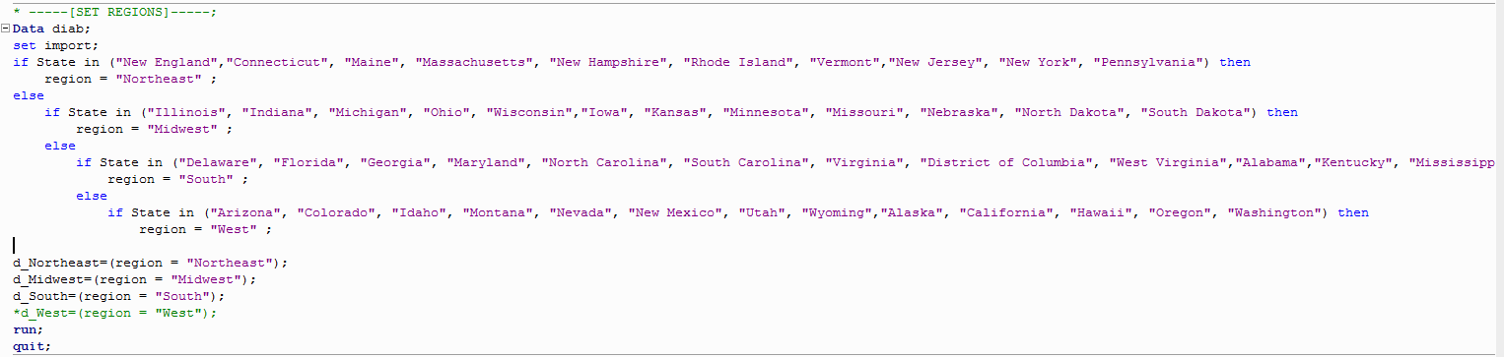
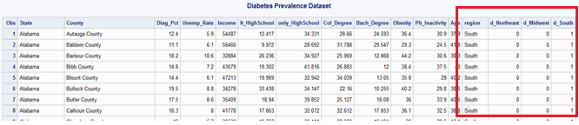

Data Processing contd..
Add dummy variables for Regions (d_Northeast, d_Midwest, d_South)
Notes:
Included the region values programmatically. The dummy variables are created based on that.

Slide 10
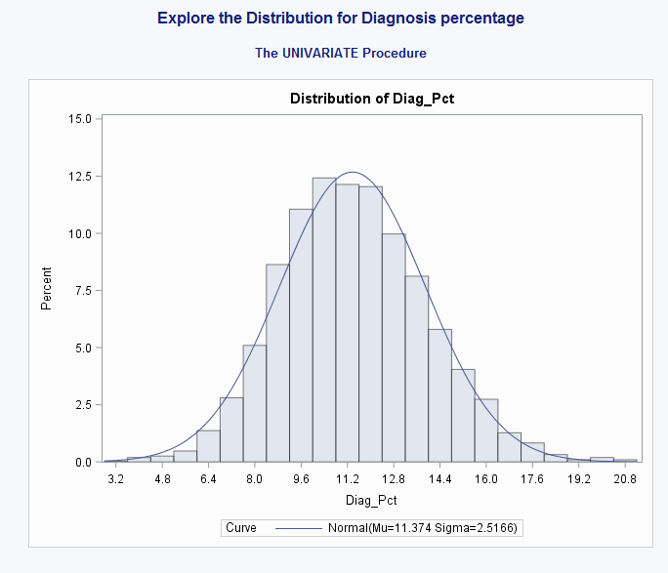
Analysis & Results
Distribution of Diag_Pct – Normal & Symmetric
Notes:
Distribution looks normal and symmetric. No transformation needed.

Slide 11
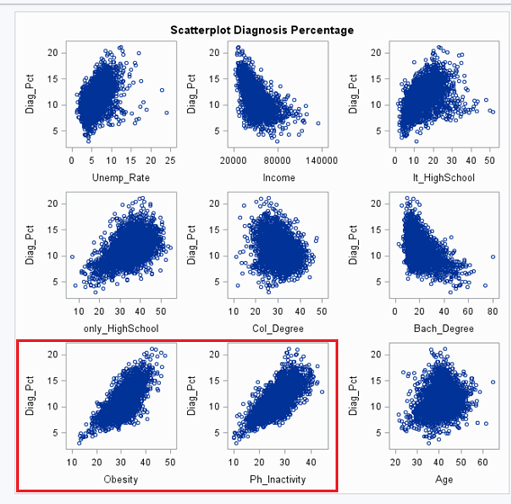
Analysis & Results
Correlation between X and Y variables
Strength\Polarity | Positive | Negative
Weak | Age | Col_Degree, d_Northeast, d_Midwest
Moderate | Unemp_Rate,lt_HighSchool, only_HighSchool, Bach_Degree, d_South | Income
Strong | Obesity, Ph_Inactivity | None
Notes:
I see a strong positive relation with Obesity and Ph_Inactivity here. Let’s see how they can help with prediction.

Slide 12
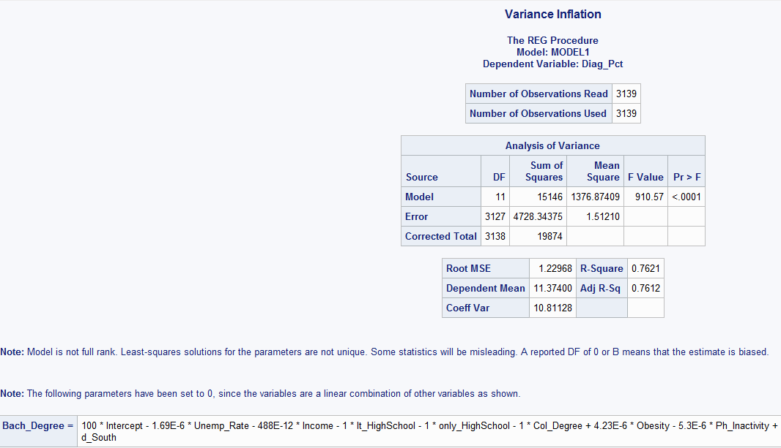
Analysis & Results
Multicollinearity
Bach_Degree is gone!
Notes:
While I attempted to check multicollinearity SAS reports that Bach_Degree is a linear combination of other variables. Hence removed it.

Slide 13
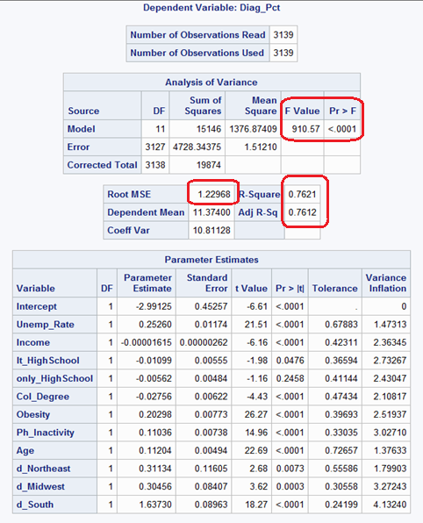

Analysis & Results
Model fitting with all variables
Notes:
No sign of multicollinearity either.
So no with 11 variables the current model looks like this. It already looks like a somewhat a good fit, but let’s remove the outliers and check it out.

Slide 14
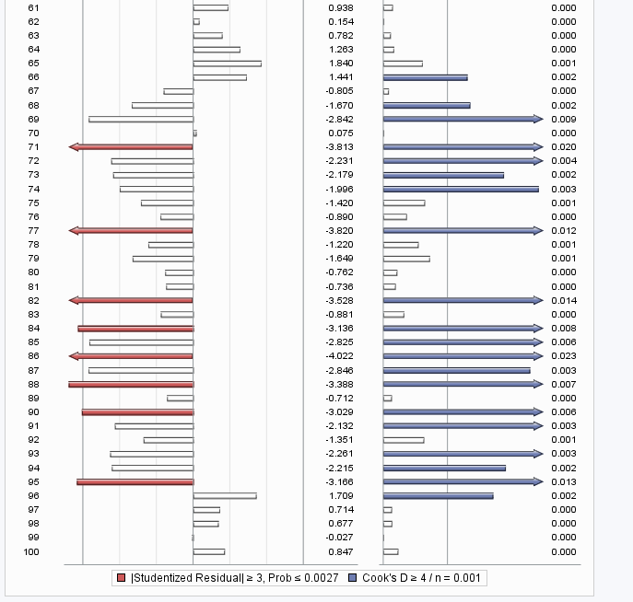
Analysis & Results
Removing outliers
3139 -> 2982 observations(157 removed)
Notes:
Removed 157 variables based on their DFFITS value.

Slide 15
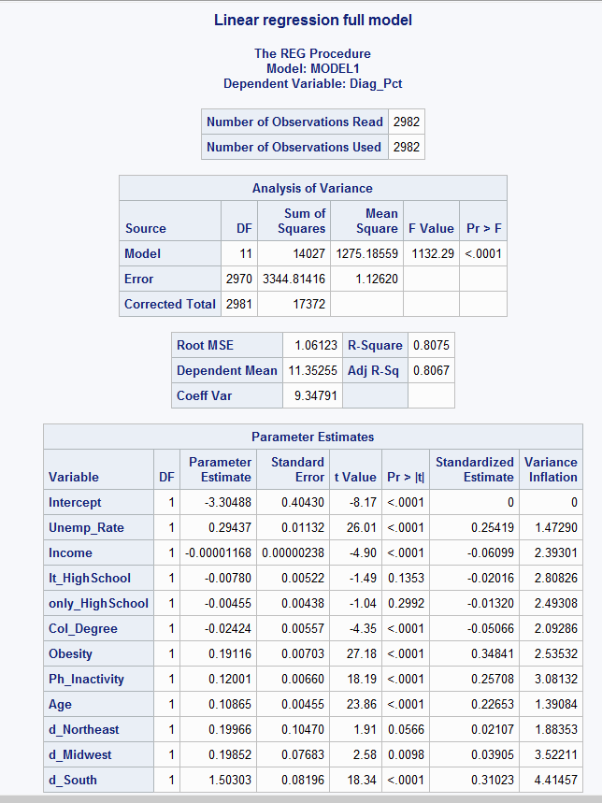
Analysis & Results
After removing outliers
Notes:
Better on the F value and Adj R-Sq. RMSE is less as well. Also the highschool related variables aren’t significant, let’s see if they go away in training phase.

Slide 16
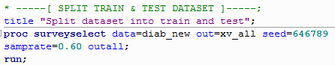
Analysis & Results
Train and Test Data
Train 60% : Test 40%
Notes:
Split the data into 60 :40 for training and testing using surveyselect.
And ran model selection methods

Slide 17
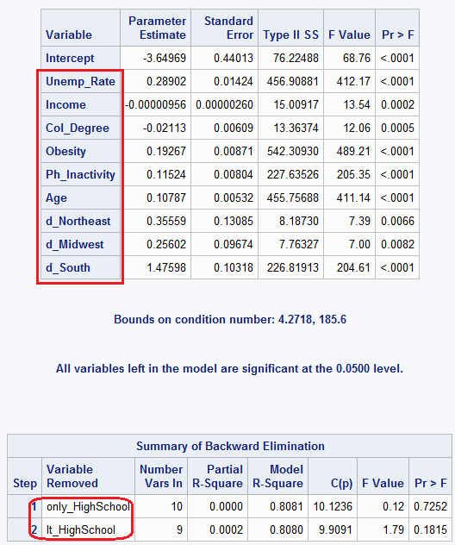

Analysis & Results
Linear Model Estimation : Test
Selection Method : Backward Elimination (M1)
9 X-Variables
Notes:
On backware elimination method, it removed the high schoold degree only, and less that highscool variables. Now left with 9 variables.

Slide 18
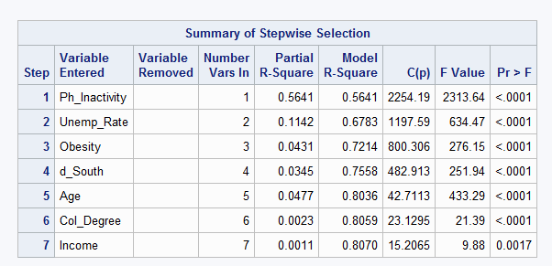
Analysis & Results
Selection Method : Stepwise Selection(M2)
7 X-Variables
Notes:
On stepwise it removed 4 variables including the d_Midwest and d_West dummy variables. Now we have 7 significant variables left.

Slide 19
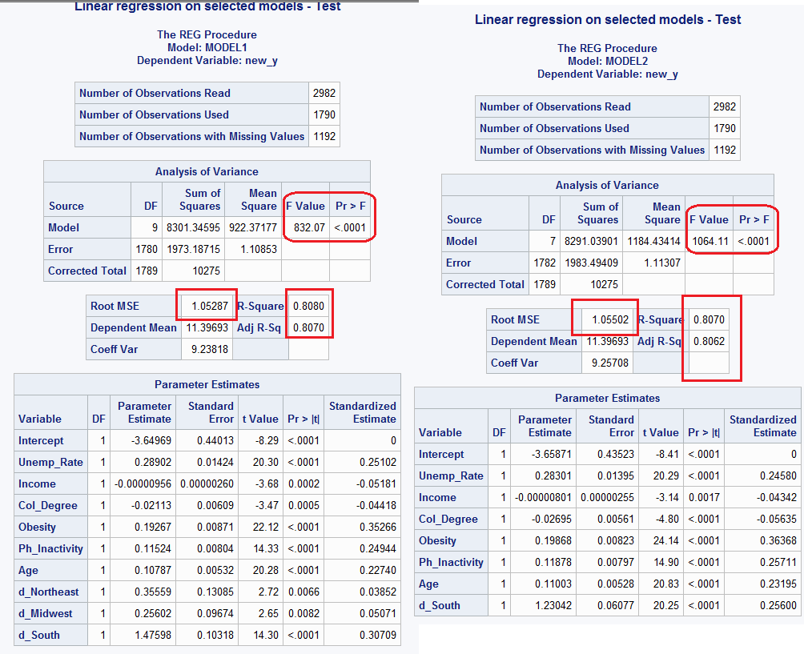
Analysis & Results
M1 & M2 summary
Notes:
Here are the final two models I have from the two different selection methods. 2nd has a better F value, the rest are almost similar.

Slide 20
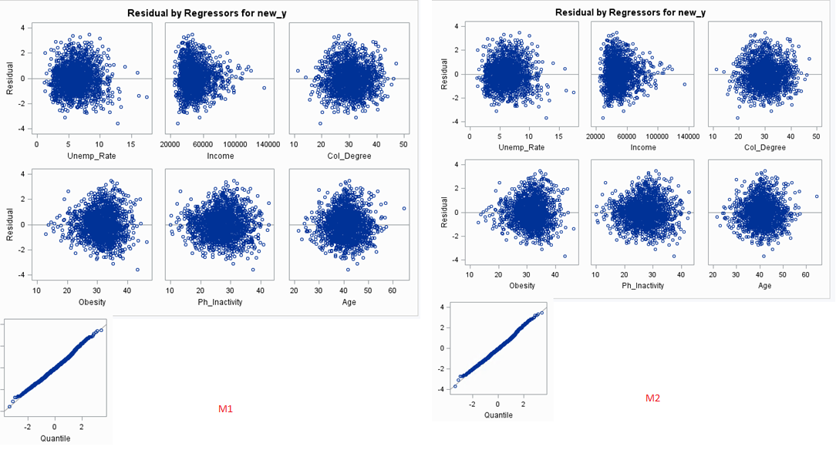
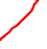
Analysis & Results
M1 & M2 Residuals
Notes:
Residuals are okay, except income but it’s not so alarming.
Let’s check how they perform on test dataset.

Slide 21
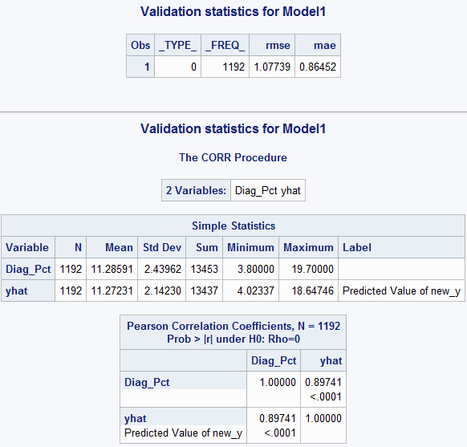
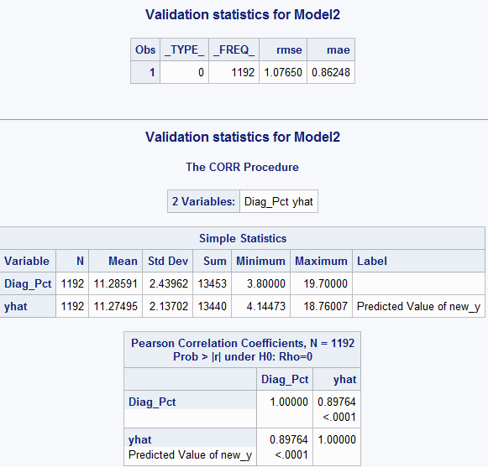
Analysis & Results
Test Data Validation (M1 & M2)
Train |  | Model 1 | Model 2
 | RMSE | 1.05 | 1.05
 | R-Square | 0.808 | 0.807
 | Adj-R-Square | 0.807 | 0.806
 | GOF | (OK)F=832/<0.0001 | (OK)F=1064/<0.0001
 | Residuals | OK | OK
Test
 | RMSE | 1.07739 | 1.0765
 | MAE | 0.8645 | 0.8624
 | R-Square | 0.805344708 | 0.80575757
 | Adj-R-Square | 0.80385782 | 0.80460156
 | CV-R-Square | 0.002655292 | 0.00124243
Notes:
On the test data, computed the new_y variables and found their difference from the observed. This is how they performed. Calculated the cross validated r square.
M2 has better Adj-Rsq, CV-Rsq.

Slide 22

Conclusion
Model Equation
Diag_Pct = -3.66 + 0.28 Unemp_Rate - 0.00001 Income – 0.027 Col_Degree + 0.20 Obseity + 0.12 Ph_Inactivity + 0.11 Age +1.23 d_South
The significance of the predictors goes in this order
Obesity > Ph_Inactivity > d_South > Unemp_Rate > Age > Col_Degree > Income
Notes:
In comparison model 2 seems to perform slightly better, hence the I chose that model as my result. Here is it’s full equation.

Slide 23
Differences in Methodology and Model Selection: William Chirciu

Slide 24
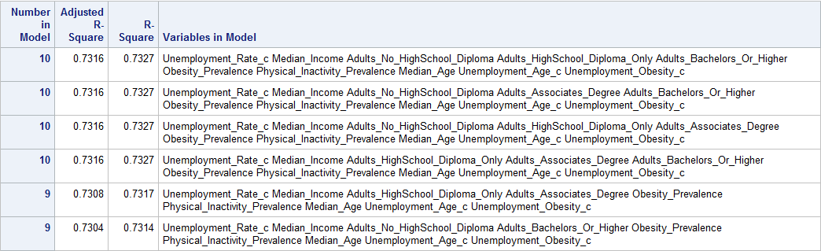
William Chirciu: Model Selection
Adjusted R-Square Model Selection – 9 predictors
Adults with Bachelor’s Degree or higher – Linear Combination
Maximize Adjusted R-Square, Minimize # Predictors

Slide 25
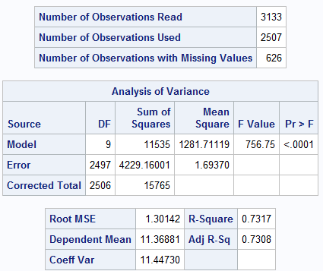
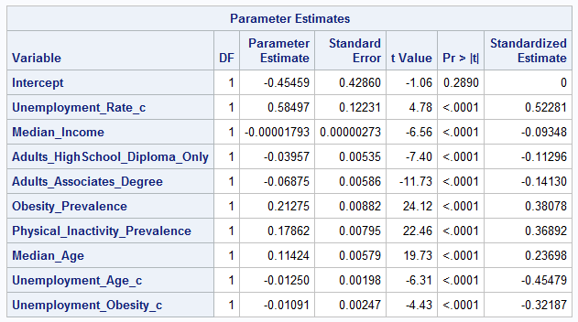
Model Evaluation- Training Set
Model Error
F-Statistic & R-Square
Effect of Attributes on Diabetes Prevalence
Standardized Estimates

Slide 26
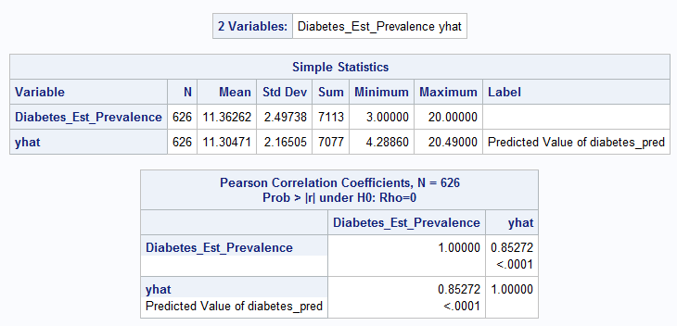
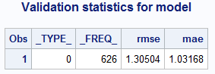
Model Evaluation- Test Set
Light difference in Means
R-Square: 0.85272^2 = 0.72713
Adj. R-Square : 0.72314
RMSE: 1.30504
MAE: 1.03168

Slide 27
Differences in Methodology and Model Selection: Charles Saporito

Slide 28
Model Selection Process Charles Saporito
On the test and train data the model was selected using two processes
Stepwise
C(p)
Stepwise Method
Produced a Model with the following descriptive
Removed the x-variable of those with a Bachelors degree
All other variables remained Significant in predicting the prevalence of diabetes in U.S. Counties.
R-sq 74.74% of variation explained by the x-variables on diabetes diagnoses percentages within the counties
A F-value of 866.77 suggested this model was strong for producing predictions of diabetes prevalence.

Slide 29
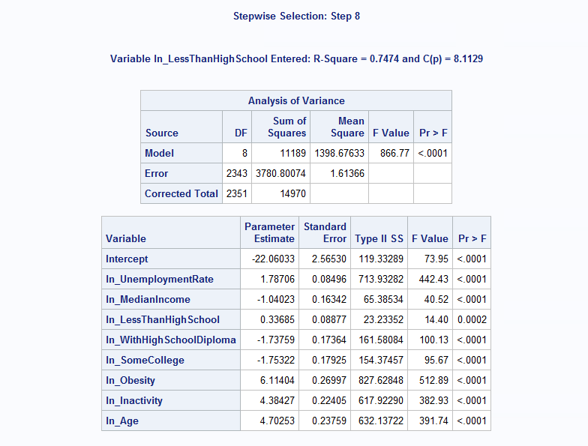
Model Selection Continued
C(p) Method
Selected the model with the highest predicting ability
Highest predicting ability output was C(p) 8.1129
Model Decision
Decided to use the model from the stepwise method
Was a well suited model with overall goodness of fit and contained a predicting ability based on C(p) of 8.1129 with a relatively high r-sq with all variables significant for prediction.

Slide 30
Model Performance Charles Saporito
After Model Selection model performance was written for the test data
A Prediction model was created on test data to see how the model would perform in predicting diabetes prevalence
Tested on random sample data
Data split was .75
Output Produced
F-value 948.63
R-sq 73.20%
Adj-r-sq .7312
Performance
A well fitted predicting model
Variation is explained well for the x-variables on the percentage of those diagnosed

Slide 31
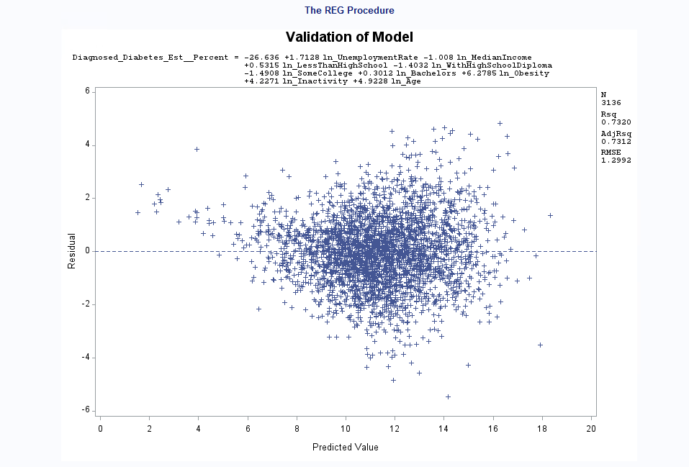
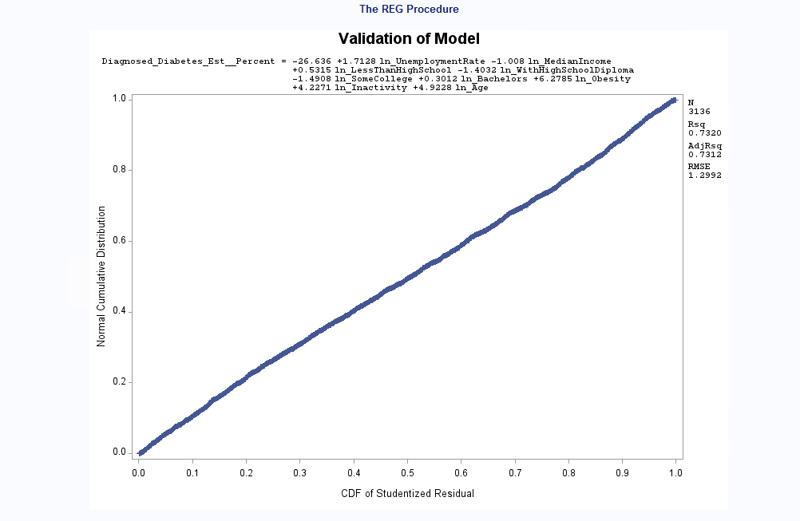
Model Validation Charles Saporito
Looked at residuals on the predicted values to check if the model met all assumptions
Met constant variance
Assumed independence
Errors were linear and normal
Error rate based on root MSE was 1.29
A low rate of error in the model

Slide 32
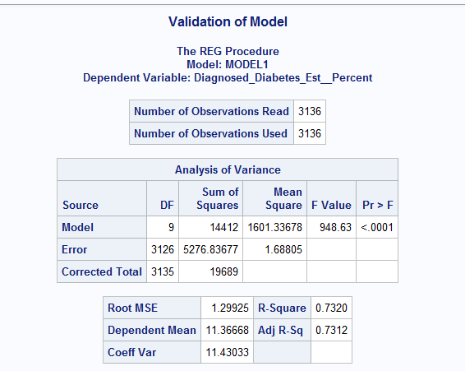
Full Regression Model Charles Saporito
Through my Analysis this was the model created by me to predict Diabetes prevalence among U.S. Counties

Slide 33
Model Statement Charles Saporito
Below is the Model Statement for my Model
Diabetes Prevalence= -22.06033+1.78Unemployeed-1.04MedianIncome+0.33LessThanHighSchool-1.73WithHighSchoolDiploma-1.75SomeCollege+.11Obese+4.36Inactive-4.70MedianAge

Slide 34
Differences in Methodology and Model Selection: Kalaivani Chandramohan

Slide 35
Data
The independent variables used are,
Unemployment rate
Household Median Income
Percent of adults with less than a high school diploma
Percent of adults with a high school diploma only
Percent of adults completing some college or associate degree
Percent of adults with a bachelor's degree or higher
Obesity Prevalence Percent
Leisure Time Physical Inactivity Prevalence Percent
Median Age
The dependent variable
Diagnosed Diabetes Est. Percent

Slide 36
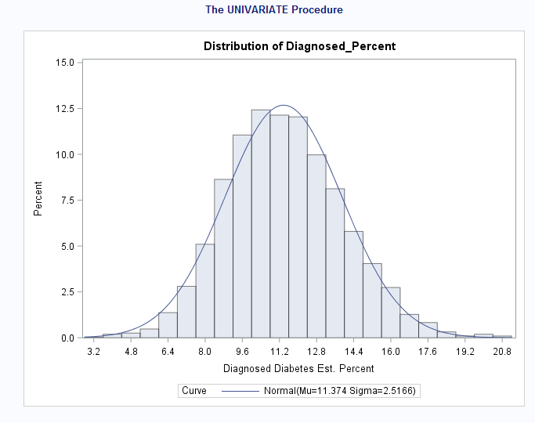
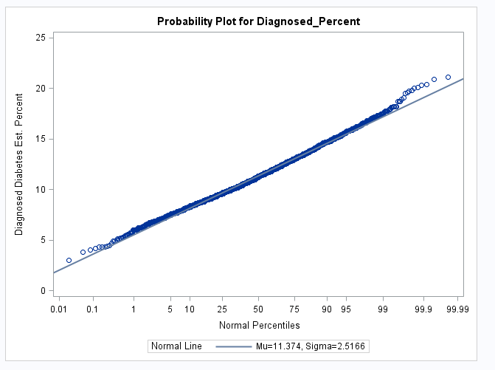
Histogram
Distribution of Diagnose percent looks normal and symmetric

Slide 37
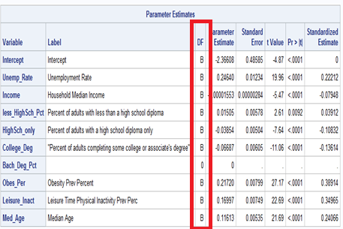
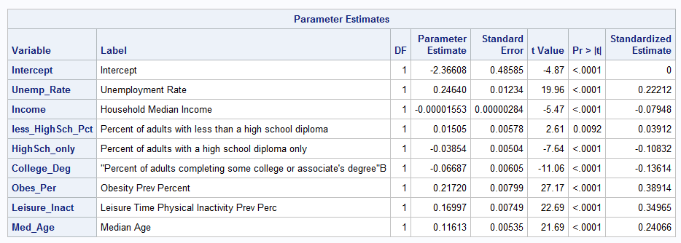
Regression Analysis
Here, the bachelor degree data is biased. Hence, it has been removed from the model
Fig 1 Fig 2

Slide 38
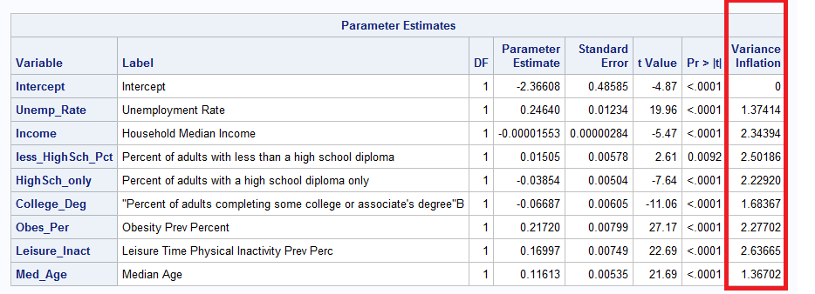
Multicollinearity

Slide 39
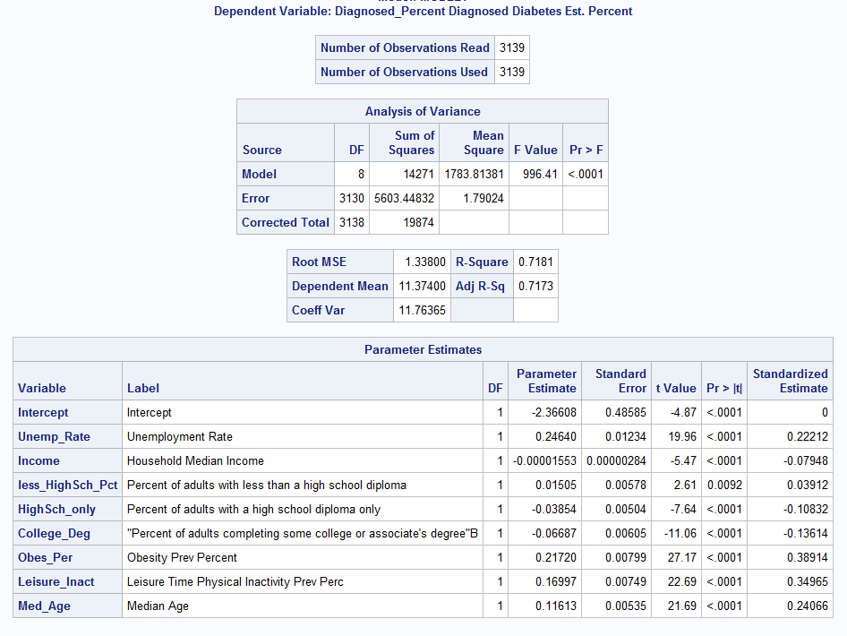
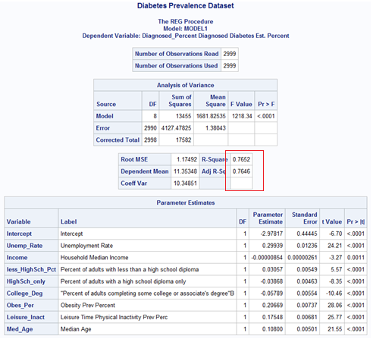

Regression model
Fig 1 : With Outliers &Influential points
Fig 2 : After removing Outliers &influential points

Slide 40
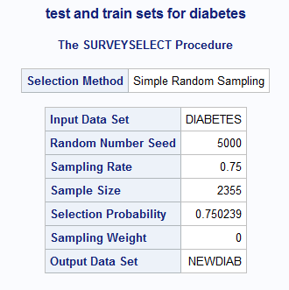
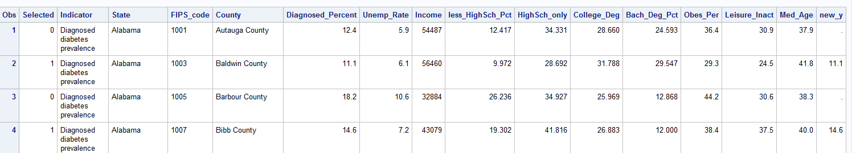

Train and test data
Train – 75% & Test -25% (Fig 1)
New_y variable has been created (Fig 2)
Fig 1
Fig 2

Slide 41
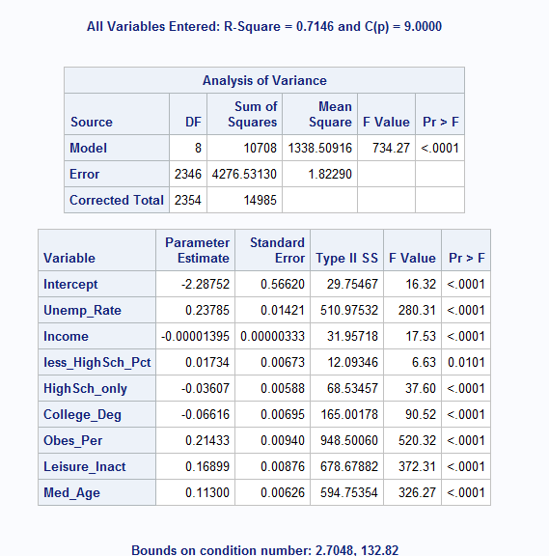
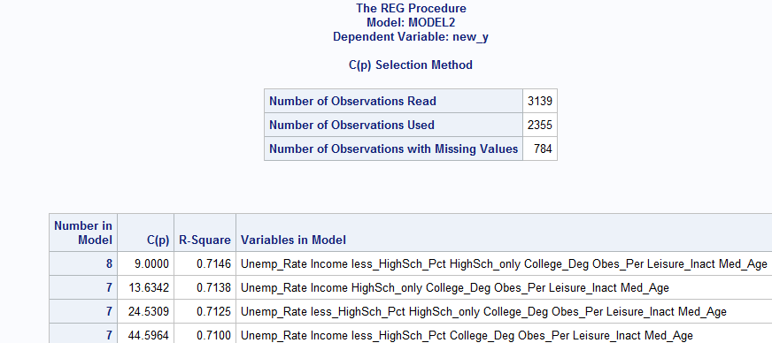

Model selection Comparison
Model 1 : Backward
Model 2: cp

Slide 42
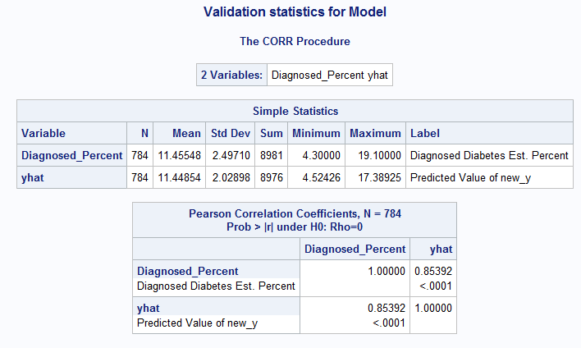

Test data validation
 | Model
Train | RMSE | 1.15341
 | R square | 0.7672
 | Adj-R-Square | 0.7663
 | GOF | ok
 | Residuals | ok
Test | RMSE | 1.35015
 | MAE | 0.98005
 | R square | 0.7146
 | Adj-R-Square | 0.7136
 | CV-R-square | 0.038020634

Slide 43
Final Model
The model equation is the following,
Diagnose_Percent = -2.94 + 0.28 Unemp_Rate - 0.00001 Income +0.036 less_Highsch_Pct -0.04 highsch_only – 0.05Col_Degree + 0.20 Obes_per + 0.1735 Leisure_Ianct + 0.11 Med_Age

Slide 44
Final Model Selection
Final model results on Test data from each team member is below:
Team Member | Adj. R Squared | RMSE | # of Variables
Max | 72.99% | 1.307 | 11
Ramkumar | 80.57% | 1.076 | 8
Will | 72.71% | 1.305 | 9
Charles | 73.12% | 1.29 | 8
Kalaivani | 71.36% | 1.35 | 8
Ramkumar’s model outperformed everyone else with his use of the regional dummy variables. Therefore, our final model equation is his:
Diag_Pct = -3.66 + 0.28 Unemp_Rate - 0.00001 Income – 0.027 Col_Degree + 0.20 Obseity + 0.12 Ph_Inactivity + 0.11 Age +1.23 d_South

Slide 45
Limitations and Future Direction
The dataset which is being used here currently shows 71% of the variation in the diabetes in explained by the rest of the predictors. To Enhance the diabetes prevalence from 71% to 90% (or above) by including couple of factors like Gender, Hypertension percentage, prediabetes, smoking habits and the alcohol consumption rate can bring a better model

Slide 46
Reference Methodologies
The other studies referenced in our analysis included similar variables
The NCD Risk Factor Collaboration study used BMI and regions that translate to same variable.
American Diabetic association’s study finds that regions counties in the deep south exhibit more prevalence
Stanford University study reports, types of food consumed, age, obesity, urbanization are contributing factors for diabetes type prevalence. It was done using multivariate linear regression methodology.
Our methods and results are comparable to these studies we referred

